Slide 1
Machine Learning
Task [1]

Slide 2
Content:
Intro to Machine Learning
Analysis of Dataset

Slide 3
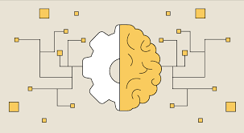
Intro of Machine Learning
Machine Learning is a field of artificial intelligence that enables computers to learn patterns from data and make decisions or predictions without being explicitly programmed. It involves training algorithms on datasets to identify trends, classify information, or forecast outcomes, allowing systems to improve their performance over time through experience.

Slide 4
Analysis of Data Set

Slide 5
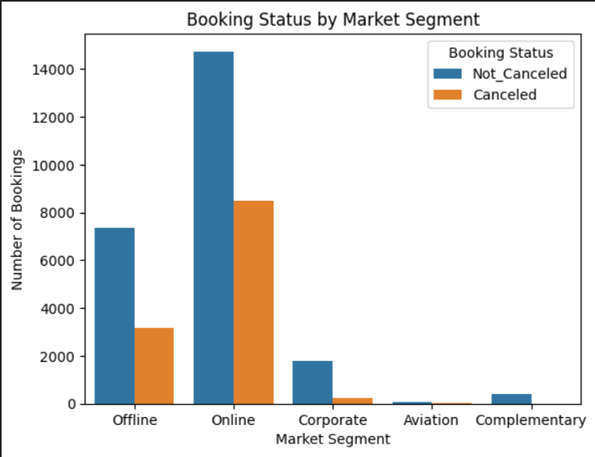
How does the market segment influence the cancellation process?
Although cancelled bookings are in the minority, most of the cancellations occurred in reservations made online.
Cancelled bookings rarely occur in the Aviation and Complementary market segments.

Slide 6
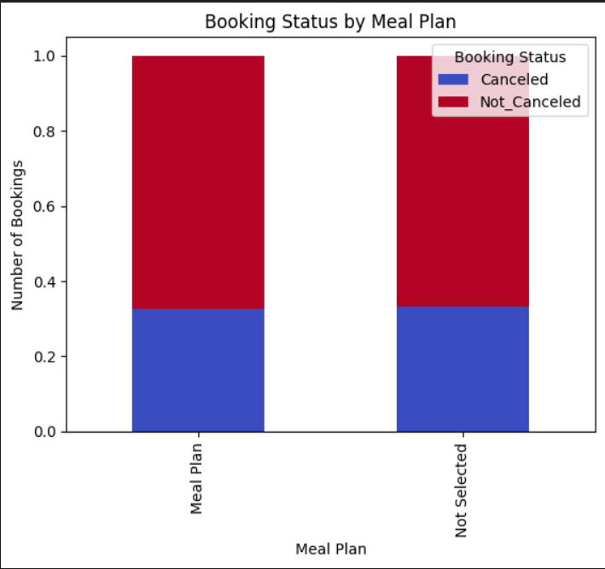
Does including a meal in the booking plan, regardless of the meal type, reduce the likelihood of cancellation?
It appears to be ineffective in cancellation decision.

Slide 7
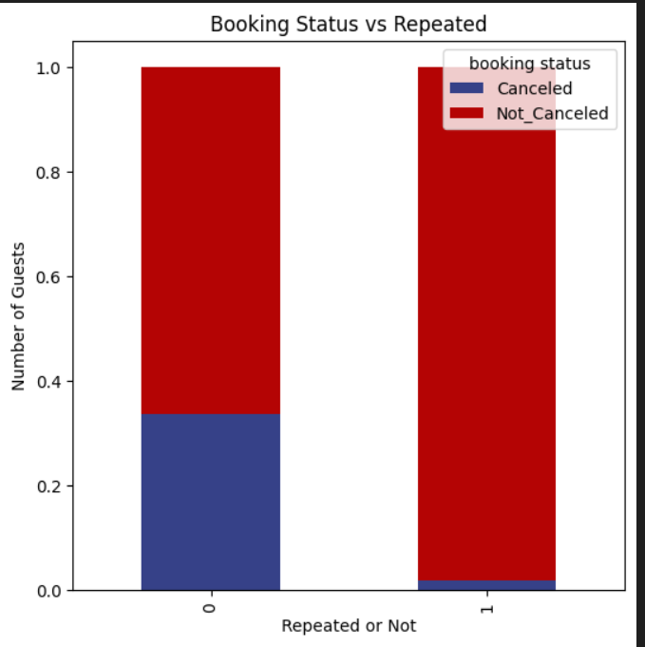
Does a guest's previous visit to the hotel influence the likelihood of cancellation?
If a guest has a previous visit to the hotel , he will probably keep the reservation.

Slide 8
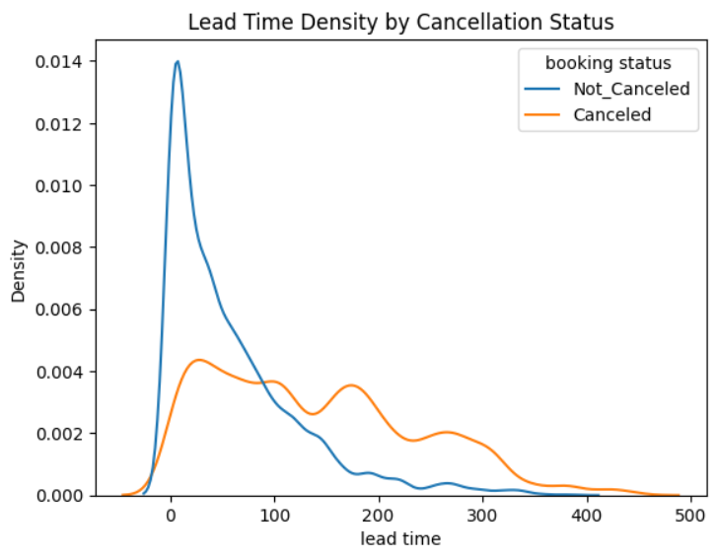
How lead time affect the cancellation process?
At low lead times, uncancelled reservations dominate, while higher lead times are associated with an increased probability of cancellation.

Slide 9
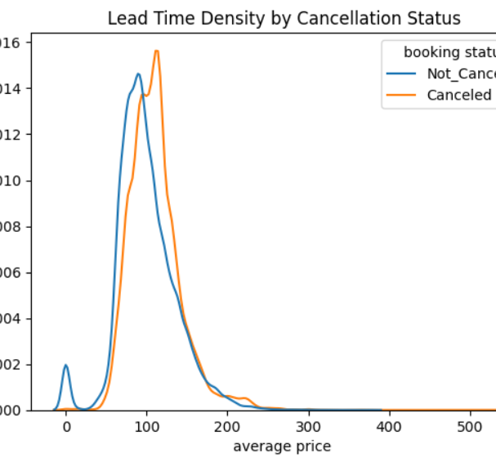
How average price affect the cancellation process?
On average, the price does not have a strong effect on cancellations. However, average price involves many factors to consider, such as fee differences based on age and booking plans.

Slide 10
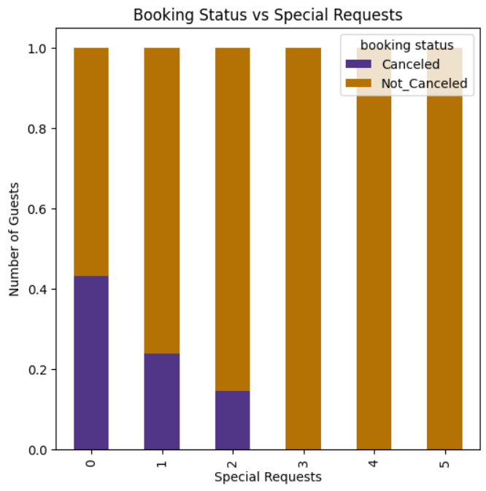
How including special requests influence the cancellation process?
More special requests correlate with fewer cancellations.

Slide 11
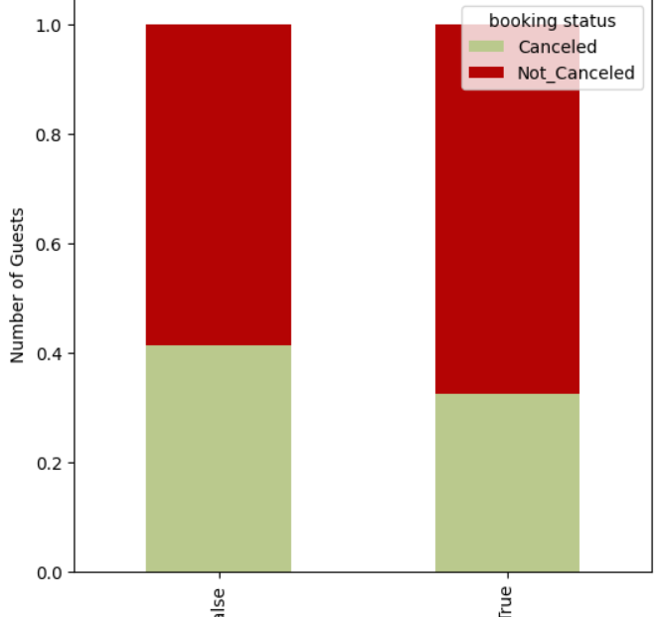
How does a higher number of adults compared to children affect the likelihood of cancellation?
Higher number of adults is associated with relatively lower cancellations.

Slide 12
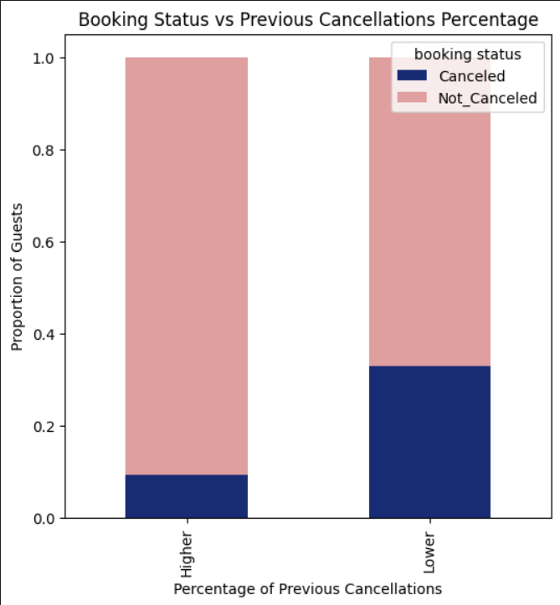
In what way does a guest’s cancellation history influence the likelihood of future cancellations?
A higher number of previous cancellations appears to reduce the probability of cancellation, possibly indicating that the guest has made a firm decision.

Slide 13


